Slide 1

Conference Culture and Climate Change
SIGPLAN
Michael Hicks
SIGPLAN Chair
Professor, Computer Science, University of Maryland

Slide 2
Conferences and Climate
Conferences are the heart of SIGPLAN (and ACM)
  Our best results appear in conference proceedings
  Networking and collaboration critical to progress
  Registrations are a significant source of revenue (enables open access, for example)
Conferences also impact climate change
  Air travel is a major contributor to carbon emissions
  No carbon-free alternatives are available for air travel (ground transport, power generation, etc. in process)

Slide 3
Climate change – quick review
Climate is warming
  This is bad
To avoid worst effects, average global warming must be kept under 2°C
  We are currently at 1.5°C
To achieve this, developed countries will need to reduce fossil fuel use by ~90% by 2050

Slide 4
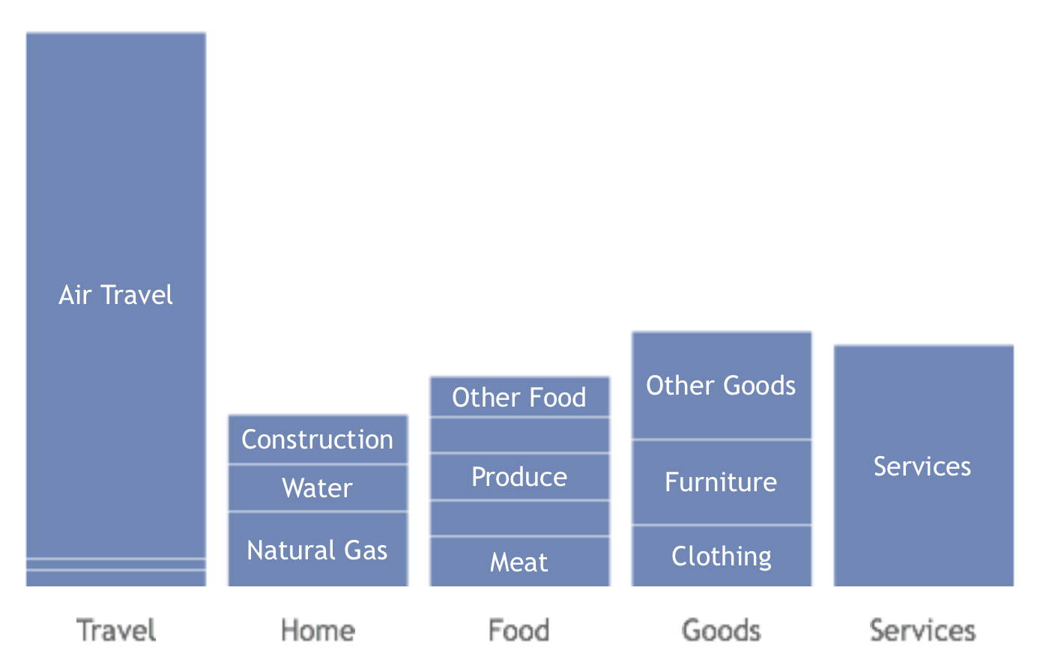
A typical POPL attendee’s family carbon footprint:

Slide 5
One Trip is 3% of Personal CO2 Budget
To have an 80% chance of limiting global warming to 2°C, cumulative carbon dioxide emissions from 2000 to 2049 must be constrained to 886 Gt.¹
The world has already emitted more than 492 Gt since 2000, leaving only 394 Gt for the world to emit.²
There are currently about 7 billion people on the planet. One computer scientist’s “fair share” of remaining allowable emissions is about 56 tons of atmospheric CO2.³
A single economy-class round trip from, say, Philadelphia to Paris emits 1.64 tons of CO2—i.e., about 3% of that computer scientist’s lifetime budget.⁴
¹Meinshausen et al in Nature
²Per the World Resources Institute's Climate Analysis Indicators Tool 2.0
³Ignoring growth in world population, and leaving aside argument that people in developing countries should be entitled to a larger share.
⁴Taking radiative forcing into account

Slide 6
Ad hoc committee on climate change
Chair of committee: Benjamin Pierce (UPenn)
  Members: Crista Lopes (UCI) and Mike Hicks (UMD)
Goal: Explore possible SIGPLAN (and ACM?) responses to conference activities’ impact on climate change
  We feel we have a responsibility to lead
    Our members want us to (survey, conversations)
  Don’t want to act hastily, or ignore the problem
Initial report shared with you today, for comment
  From Google Doc of the agenda

Slide 7
Understanding Impacts
How much do conferences contribute to CO2 emissions?
  Impact of mitigations requires understanding costs
  Estimated 700 tons for PLDI’16, per http://www.pl-enthusiast.net/2016/06/08/carbon-footprint-conference-travel/
Idea: Develop software that can estimate the cost based on attendee registration information
  Include in regular reports

Slide 8
Carbon Offsets
These are (purchasable) actions meant to counterbalance CO2 emissions
  Planting trees, investing in green energy projects, investing in energy production research, …
Arguments for/against
  Best case: Buys time until 2°C is reached
  Worst case: We ignore emissions
Idea: Build in to conference registration. Or, SIGPLAN pays for them after the fact

Slide 9
Changes to PC Meetings
Oftentimes, PC meetings are held in person
  General belief is that outcomes are better
  Great networking opportunity, especially for young researchers
  But travel cost (in terms of CO2) for the benefits
Ideas
  Online PC meetings, with at-conference gathering
  Split physical meetings
  Colocate meeting with another conference many PC members would normally attend
    PLDI’16 PC meeting held at POPL’16. But only handful would have attended POPL’16 anyway.

Slide 10
Carbon-friendly Conference Planning
Location of conference affects carbon cost
  Long/multi-hop trips for more people means greater cost
But expansion to new locations broadens community
  Don’t want every conference in Chicago, IL, USA!
Idea: Pick location with likelihood proportionate to expected carbon cost
  Relative to best-case baseline

Slide 11
Optional/Remote Participation
Publish paper in conference proceedings (PACMPL) but don’t attend
  E.g., “journal first” model
Remotely attend
  Livestreaming, online participation (chat, hangout, Twitter)
  Examples: CHI’16 remote presence avatars (expensive!); SIGCOMM’16 remote presentations

Slide 12
Reducing Conference Events
Merge existing conferences into a “mega conference”
  Like SC, CHI, SIGGRAPH, …
  So: PL’20 as POPL’20 + PLDI’20 + ICFP’20 + OOPSLA’20. Latter become “tracks” of the former
Regional or multi-site conferences
  Simultaneous European and North American events with “remote participation” between
AR/VR: the virtual conference!

Slide 13
Summary
Conferences are great for science
Conference travel is not great for the environment
  We are nearing a critical point if we are to avoid the most serious problems that scientists predict
  One European flight is 3% of my lifetime CO2 budget!
How can we balance the two concerns?
  Your feedback (and action) is welcome!
  mwh@cs.umd.edu

Slide 14
Carbon and Travel
Flights are particularly problematic
  JFK to SFO = 1.15 metric tons of carbon, per economy-class passenger, on average
  CDG to SFO = 2.49 metric tons
  HDG to JFK = 3.02 metric tons
  Multi-hop flights add a bump due to takeoff
Compare
  Average American = 20 metric tons per year
  Average Industrial natio = 11 metric tons per year
  Driving 10,000 miles @ 30 MPG = 3.31 metric tons

