Slide 1
ACM SIG Orientation Publications Overview
Scott Delman
ACM Director of Publications
September 18, 2017
The ACM is the world’s leading publisher of scientific and technical information and conference organizer in the field of Computing

Slide 2
Contents
ACM Publications Board
Vision & Strategy for ACM Publications
Publications Portfolio
New Publications
Publications Policies
Ethics & Plagiarism
Open Access

Slide 3
ACM Publications Board
Co-Chairs: Jack Davidson
Joseph A. Konstan
SGB Liaison: Yannis E. Ioannidis
Members: Phoebe Ayers
Karin K. Breitman
Terry J. Coatta
Anne Condon
Nikil D. Dutt
Roch Guerin
Chris Hankin
Carol Hutchins
Michael Nelson
M. Tamer Ozsu
Eugene H Spafford
Stephen N. Spencer
Alex Wade
Keith Webster
Julie R. Williamson
Committees
Assessment & Search
Ethics & Plagiarism
New Publications
Digital Library
Conference
Practice
Business Working Group

Slide 4
Vision & Strategy for ACM Publications
To retain & expand position as the premier publisher in Computer Science
ACM is one of the most trusted brands in Computer Science and is synonymous with quality. ACM should be the first place researchers, students, educators, and advanced-level practitioners from every major area in Computing should go to publish their best work and to search for high quality published literature.
  Strengthen existing publications
  Provide a great experience for authors, editorial boards, and volunteer leaders
  Launch new publications for researchers, practitioners, and educators
  Partner with 3rd parties and develop deeper ties to research & practice communities

Slide 5
ACM Publications Portfolio
Journals (50)
  Traditional Journals & Transactions (45)
  New Proceedings of the ACM Journal Series (4)
  New ACM Transactions on Human-Robot Interaction (1)
Magazines (8)
  Communications of the ACM
  Interactions Magazine
  InRoads Magazine
  Computers in Entertainment Magazine
  eLearn Magazine
  ACM Queue
  Ubiquity Magazine
  XRDS Magazine
SIG Newsletters (37)
SIG Conference Proceedings (too many to count…..)
ACM Books (17 published, 21 under contract being written)

Slide 6
New Titles Under Consideration / Development
  Digital Threats: Research & Practice (approved…under development)
  ACM Transactions on Data Intensive Computing (approval later this week)
  Internet of Things: Research & Practice
  ACM Transactions on Middleware
  ACM Transactions on Digital Health
  ACM Transactions or Journal on Communications Design (new proposal from SIGDOC)
  Data Science Magazine (under development by SIGKDD)
  Evaluation Process Includes SIGs Always

Slide 7
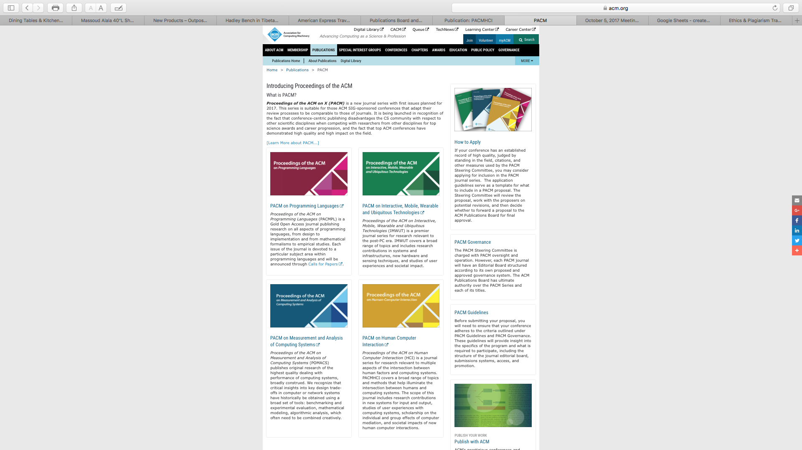
Proceedings of the ACM (PACM)
https://www.acm.org/publications/pacm
PACM on Programming Languages
PACM on Interactive, Mobile, Wearable and Ubiquitous Technologies
PACM on Measurement and Analysis of Computing Systems
PACM on Human Computer Interaction

Slide 8
Publications Policies
  All ACM Publications, including SIG Newsletters and Conference Proceedings, are governed by ACM Publications Policies, so it is important to be aware of the policies
  http://www.acm.org/publications/policies/toc
  ACM Publications Board Oversees All ACM Policies, but seeks advice and input when major changes effecting SIGs & Other Stakeholders impacts
  Significant Changes in Recent Years Relating to Author Rights, OA, etc.

Slide 9
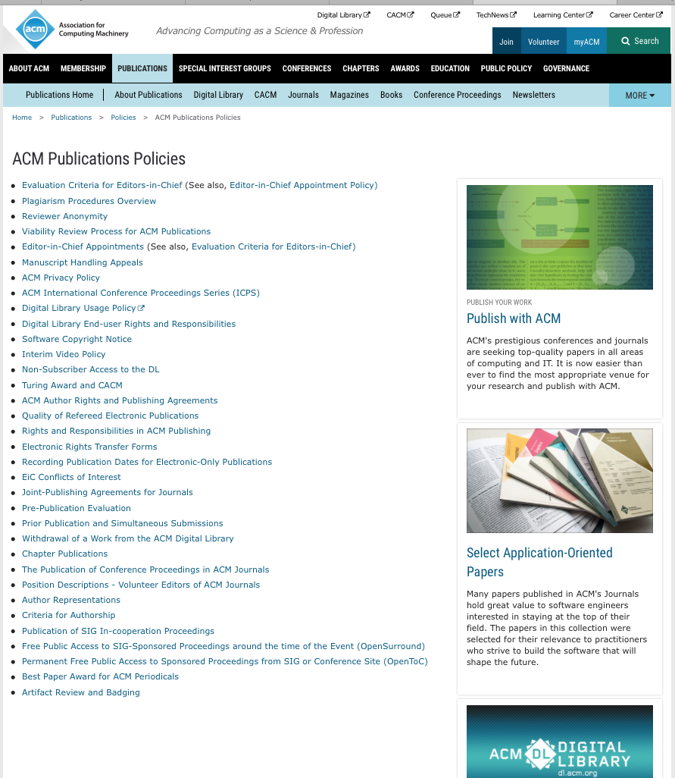
Publication Policies Page
* Plagiarism Procedures
* Author Rights & Agreements
* Rights & Responsibilities
* OpenSurround
* OpenTOC
* Artifact Review and Badging

Slide 10
Ethics & Plagiarism
Rising Number of Complaints from All Parts of the World
Many of these relate to Conference Proceedings Articles
Depending on Type of Complaint, Investigation led by Program Committee Chairs or ACM Publications Board Ethics & Plagiarism Committee (Eugene Spafford, Chair)
In some cases ACM Committee on Professional Ethics (see https://ethics.acm.org)
ACM Headquarters Facilitates Process & In Certain Cases Makes Determinations
ACM Now Offering Use of iThenticate Similarity Check Tool
If an issue arises, please contact me or Eugene Spafford

Slide 11
Open Access
ACM has made great progress in recent years with OA
Major changes to Author Rights & Posting Policies in last 2-3 years
Authorizer Tool- Author posted links to OA versions of DL articles
Hybrid Open Access Option for all ACM Publications in 2013
Leadership with CHORUS (see https://www.chorusaccess.org)
OpenSurround
OpenTOC
Gold Open Access Journals – 2017 & 2018

Slide 12
Open Access
ACM has made great progress in recent years with OA
Major changes to Author Rights & Posting Policies in last 2-3 years
Authorizer Tool- Author posted links to OA versions of DL articles
Hybrid Open Access Option for all ACM Publications in 2013
Leadership with CHORUS (see https://www.chorusaccess.org)
OpenSurround – 30 days of free access to Conference Proceedings
OpenTOC – TOCs with Authorizer links posted on Conference or SIG sites
Gold Open Access Journals – 2017 & 2018

