Slide 1
SGB Orientation
Finance Overview
      ACM Finance
      2 Penn Plaza, Suite 701
      New York, NY 10121

Slide 2
SIGs Structure
SGB
SIGs (37)
Organizations
Conferences

Slide 3
Tax Status
Not–for–Profit Organization
Exempt from Federal Income Taxes under Section 501 (c) (3) of the Internal Revenue Code
Consumption Taxes
  Exempt from Sales Taxes in some states
  Not Exempt from Goods and Service Taxes (GST)
  Not Exempt from Value Added Taxes (VAT)

Slide 4
Consumption Taxes
Sales Taxes
  Not Charged on Registration Fees
  Not Paid on Expenses in Exempt States
Goods and Services Taxes (GST)
  Fees vary based on host country’s rules
  Exemption opportunities differ based on host country’s exemption rules
  Must meet the specific geographical attendance metrics of the host country to qualify for exemption on registration fees
  Ability to reclaim a portion of the taxes paid on expenses (after event) if income exemption is obtained
Value Added Taxes (VAT)
  Charged on Registration Fees
  Paid on Expenses
  Ability to reclaim a portion of taxes paid on expenses (after event) if the specific host country’s compliance rules are met

Slide 5
Consumption Tax Variables
Location
Host Country’s Laws
  Tax Rates
  Thresholds
Relationships with Associated Organizations
  Universities
  Third Party Sponsors
Frequency of other ACM events within the different host countries

Slide 6
Financial Terms
Fiscal Year - July to June
  FY 2018: July 1, 2017 to June 30, 2018
Conference Fiscal Year – March to Feb
  FY 2018: March 1, 2017 to February 28, 2018

Slide 7
Financial Terms
Revenue / Income
  Funds received in exchange for goods and services
Expenses / Disbursements
  Payments made to vendors and volunteers
Accrual Accounting
  Revenue recorded when earned and expenses
  recorded when incurred
Surplus/(Deficit)
  The net result of revenue minus expenses

Slide 8
Financial Terms
Fund Balances
  Accumulation of surpluses and deficits
Required Fund Balance
  50% of Budgeted Organization Expenses
  plus 40% of Budgeted Conferences’ Expenses
Allocation/Overhead
    Cost of being part of a larger organization
    Calculation is based on total expenses of each SIG
    Minimum Contribution is $10,000
    Starts at 16%
    Decrease by 0.8% for every $125,000 expenses

Slide 9
Major Revenue & Expense Streams
Revenue
Expenses
Membership Dues and Subscription Fees
Sponsored and Co-Sponsored Conferences
Publications, including the ACM Digital Library
Miscellaneous: Interest, Grants and Corporate Donations
Publications Production and Distribution (Newsletters, Proceedings, etc.)
Grants and Awards Programs
Travel and Meetings
Professional Services
Special Projects
Overhead

Slide 10
Financial Reports
Monthly Financial Management Reports (FMRs) are available online
  https://fmr.acm.org
Access to FMRs given to SIG Chairs and SIG Treasurers
Conference reports (CIP) are generally available to the Conference Chairs and Treasurers

Slide 11
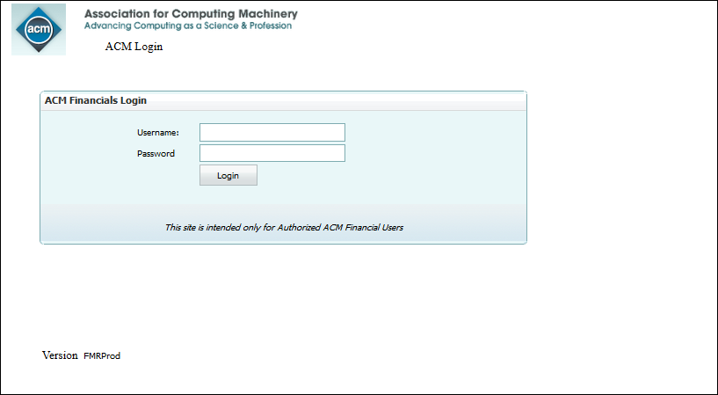
Log in FMRs

Slide 12
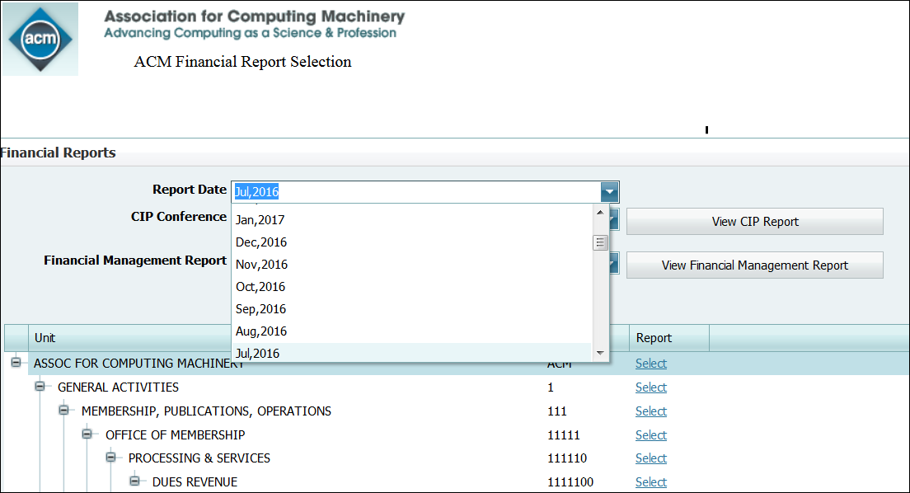
Choose report date

Slide 13
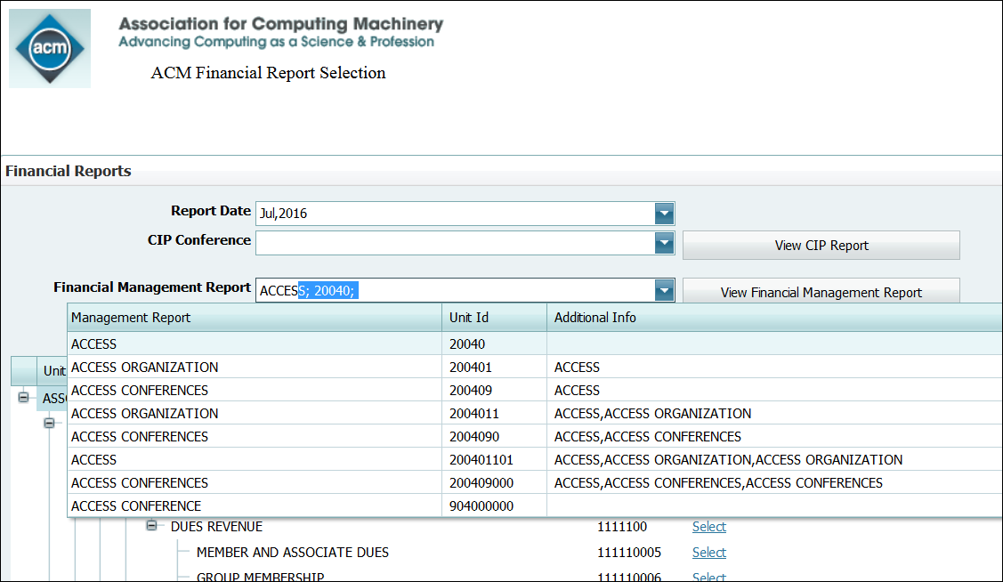
Choose FMR report by your choice

Slide 14
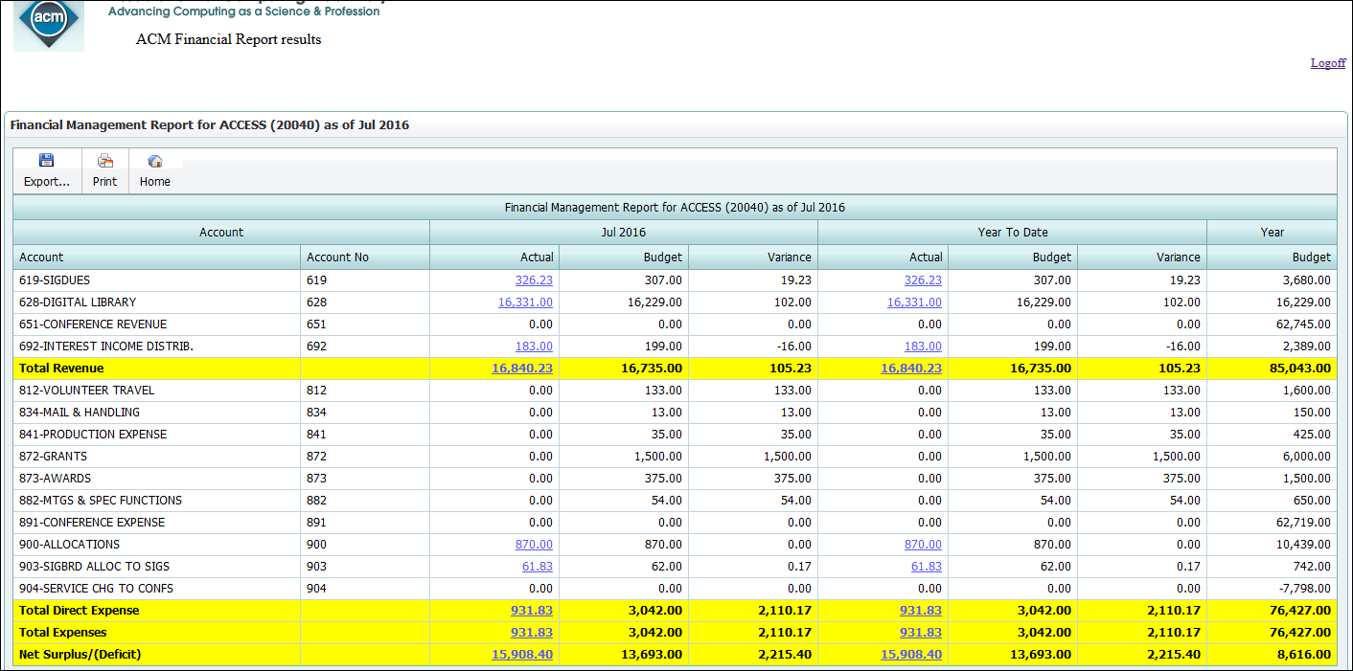
FMR Layout
Notes:
F

Slide 15
Timetable for SIGs Budget Preparation
November | Notify the SIG Chairs and Treasurers of specific timeline for next FY budget.
December | Membership Benefits due for next Fiscal Year.
December | SIG Treasurers submit any changes in member dues and subscriber rates for inclusion in the Publications Catalog as well as for use in the budget process.
January | Finance compiles and inputs appropriate data, based on membership benefits, prior year’s data and current trends in membership and subscriber statistics, conference information, current SIG expenses, etc. SIG Treasurers supply Finance with new information on existing SIG programs (Special Projects, awards, grants, etc.) and any new programs.
January to February | Finance provides SIG Chairs and Treasurers with preliminary draft of budget, for consideration and review. (Finance staff available for consultation as needed.)
February | SIG budgets are approved by SIG leaders and returned to Finance. SIG budgets are reviewed and approved by the SIG Governing Board.
March | Approved SIG budgets are included in ACM budget draft to be presented to the ACM EC and Council.
March/April | Approval at the ACM EC/Council level

