Slide 1

CEO Report
Vicki Hanson
ACM SGB Meeting
8 Nov 2019

Slide 2
ACM is Strong!
Membership September 2019
Professional membership growing
  Up 5,113 from September 2018
    Current members: 73,878
    2018 numbers: 68,765
Student numbers are growing
  Up 749 from September 2018
    Current members: 24,135
    2018 numbers: 23,386

Slide 3

Financials – 1Q 2019
ACM | FY 2020 Full Year Budget | FY 2020 September Projection | FY 2019 Full Year Actual | FY 2018 Full Year Actual | FY 2017 Full Year Actual | FY 2016 Full Year Actual
General Activities
Revenue | 28,998 | 29,074 | 29,391 | 28,096 | 27,782 | 27,648
Expenses | 28,229 | 27,796 | 26,638 | 26,105 | 26,228 | 26,406
General Activities Net | 770 | 1,279 | 2,754 | 1,992 | 1,554 | 1,242
Special Interest Groups
Revenue | 45,027 | 45,603 | 42,989 | 42,149 | 37,971 | 36,323
Expenses | 47,979 | 41,823 | 37,882 | 37,380 | 33,596 | 31,800
SIGs Net | (2,952) | 3,780 | 5,107 | 4,769 | 4,376 | 4,523
ACM Operating Net | (2,183) | 5,059 | 7,860 | 6,761 | 5,930 | 5,764

Slide 4
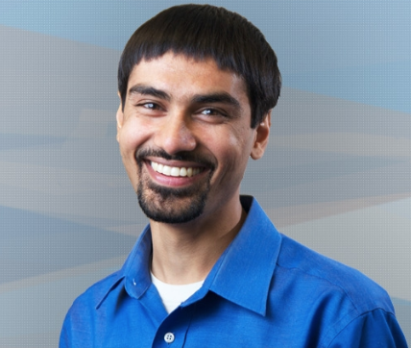



ACM Boards
Education
Undergraduate Data Science Curriculum, March 2020 SIGCSE
Practitioners
Pubs
SGB
Practitioners Board
Publications Board
Open Access
Education Board
New podcast series
Research to practice
Entrepreneurship
Women in Tech
Career & Skill Development
SIG Governing Board
Accessible conferences
Ethics and Plagiarism
Name Change Policy
Experimental meeting formats

Slide 5



Regional Councils
India
ACM India Council
Europe
China
ACM Europe Council
ACM China Council
TUR-C conference
Education
Annual event
Hefei May’20
Summer Schools
New officers
2 Summer Schools
Europe TPC
Informatics For All
ACM-WE
CECL
Women in Computing
ACM-W
Education
Chengdu May’19
Awards

Slide 6

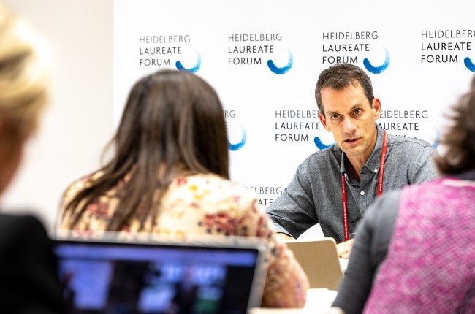
ACM Partner Activities

Slide 7
Reporting ethics violations

Slide 8
Reporting Ethics Violations
Policy Against Harassment at ACM Activities
  Applies to all ACM activities
  Applies to ACM members and non-members
  Covers discriminatory and bullying behaviors
  Website for Reporting Unacceptable Behavior at ACM Activities
ACM Policy on Plagiarism, Misrepresentation, and Falsification
  Ethics and Plagiarism Committee (Pubs Board)
  Professional ethics in publishing, e.g., reviewer and author misconduct to the inappropriate addition of author names to papers after review
    SIG conferences should add author policy on their website
  Reporting: https://www.acm.org/publications/policies/plagiarism-overview
ACM Code of Professional Ethics and Conduct
  Violations of Code are inconsistent with membership in ACM
  Applies to ACM members and ACM SIG members
  Reporting: ACM Code of Ethics Enforcement Procedures, https://www.acm.org/code-of-ethics/enforcement-procedures

Slide 9
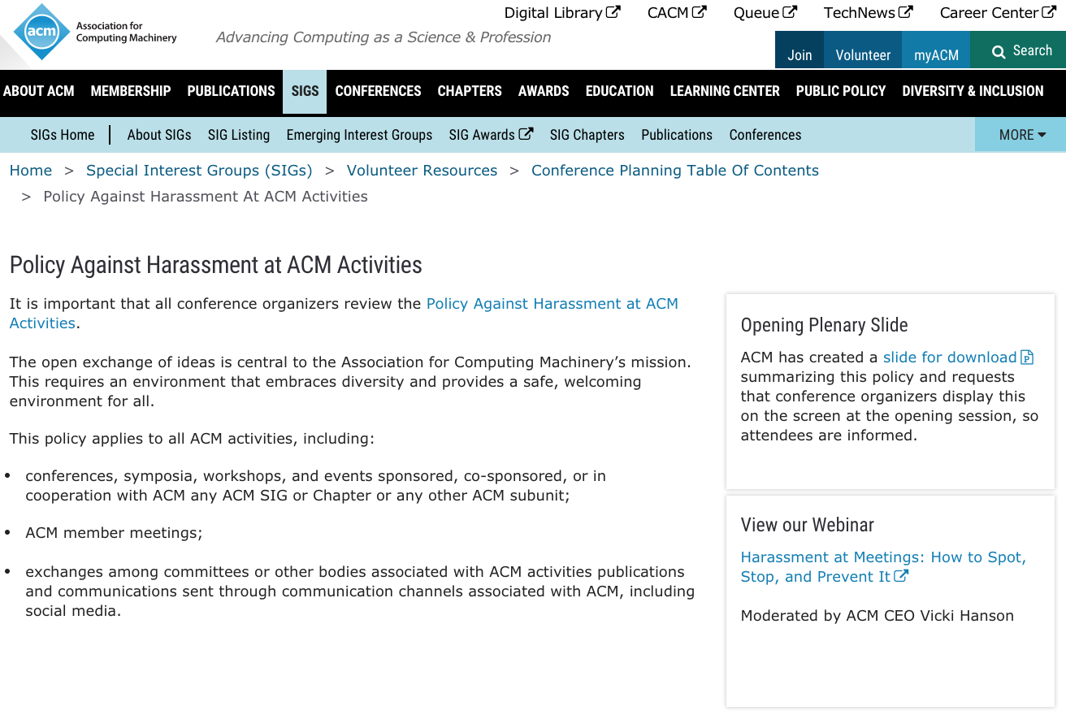
https://www.acm.org/special-interest-groups/volunteer-resources/conference-planning/opening-slide-on-acm-activities-policy

Slide 10
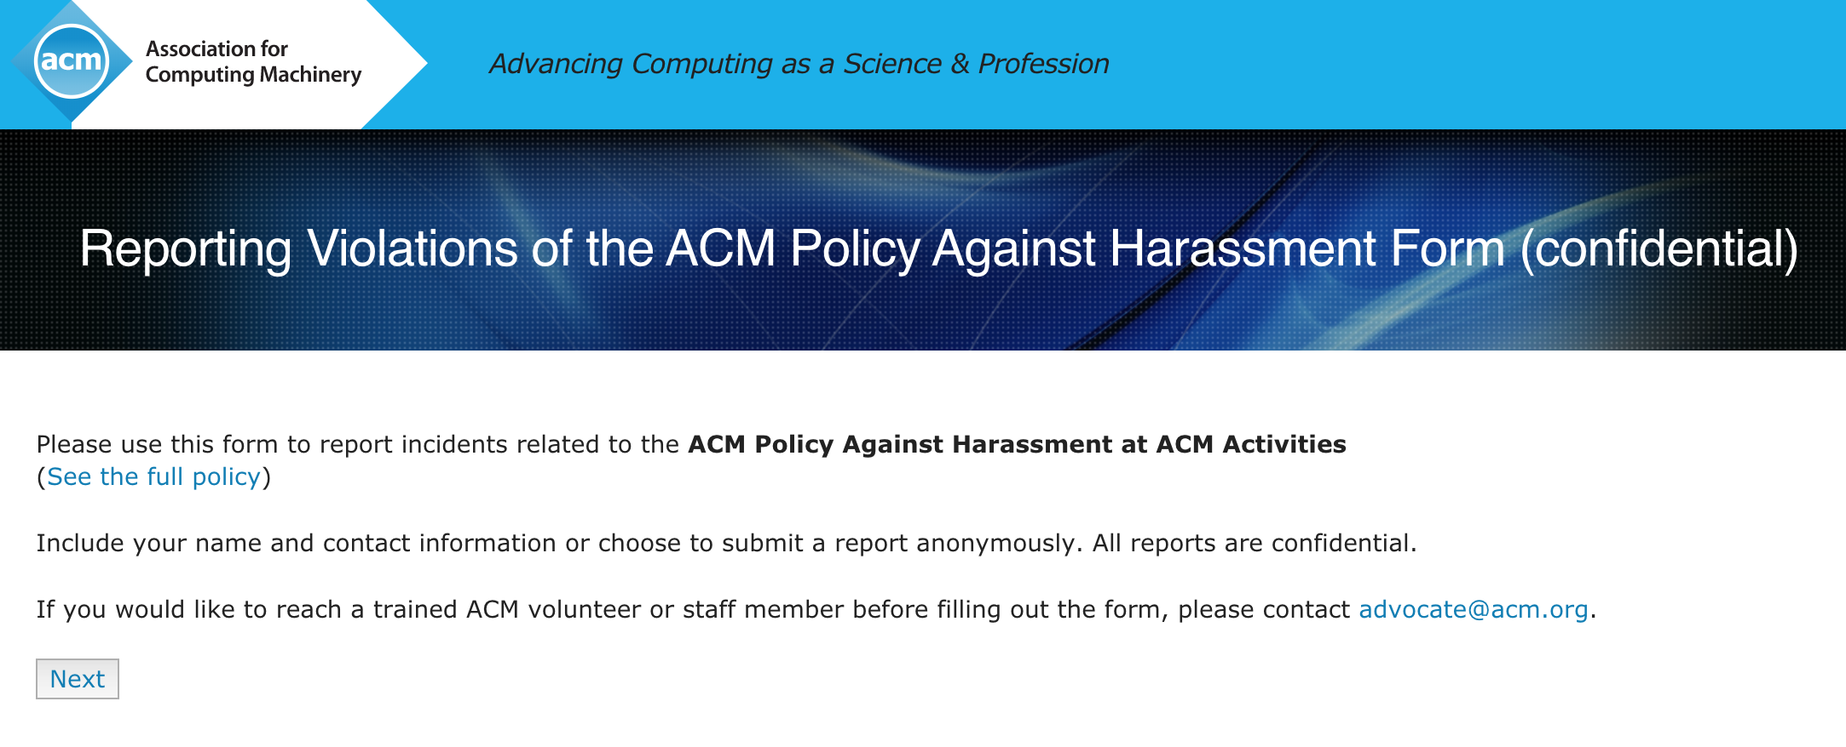

Slide 11
Reporting Ethics Violations
Policy Against Harassment at ACM Activities
  Applies to all ACM activities
  Applies to ACM members and non-members
  Covers discriminatory and bullying behaviors
  Website for Reporting Unacceptable Behavior at ACM Activities
ACM Policy on Plagiarism, Misrepresentation, and Falsification
  Ethics and Plagiarism Committee (Pubs Board)
  Professional ethics in publishing, e.g., reviewer and author misconduct to the inappropriate addition of author names to papers after review
    SIG conferences should add author policy on their website
  Reporting: https://www.acm.org/publications/policies/plagiarism-overview
ACM Code of Professional Ethics and Conduct
  Violations of Code are inconsistent with membership in ACM
  Applies to ACM members and ACM SIG members
  Reporting: ACM Code of Ethics Enforcement Procedures, https://www.acm.org/code-of-ethics/enforcement-procedures

Slide 12
Acm priorities

Slide 13
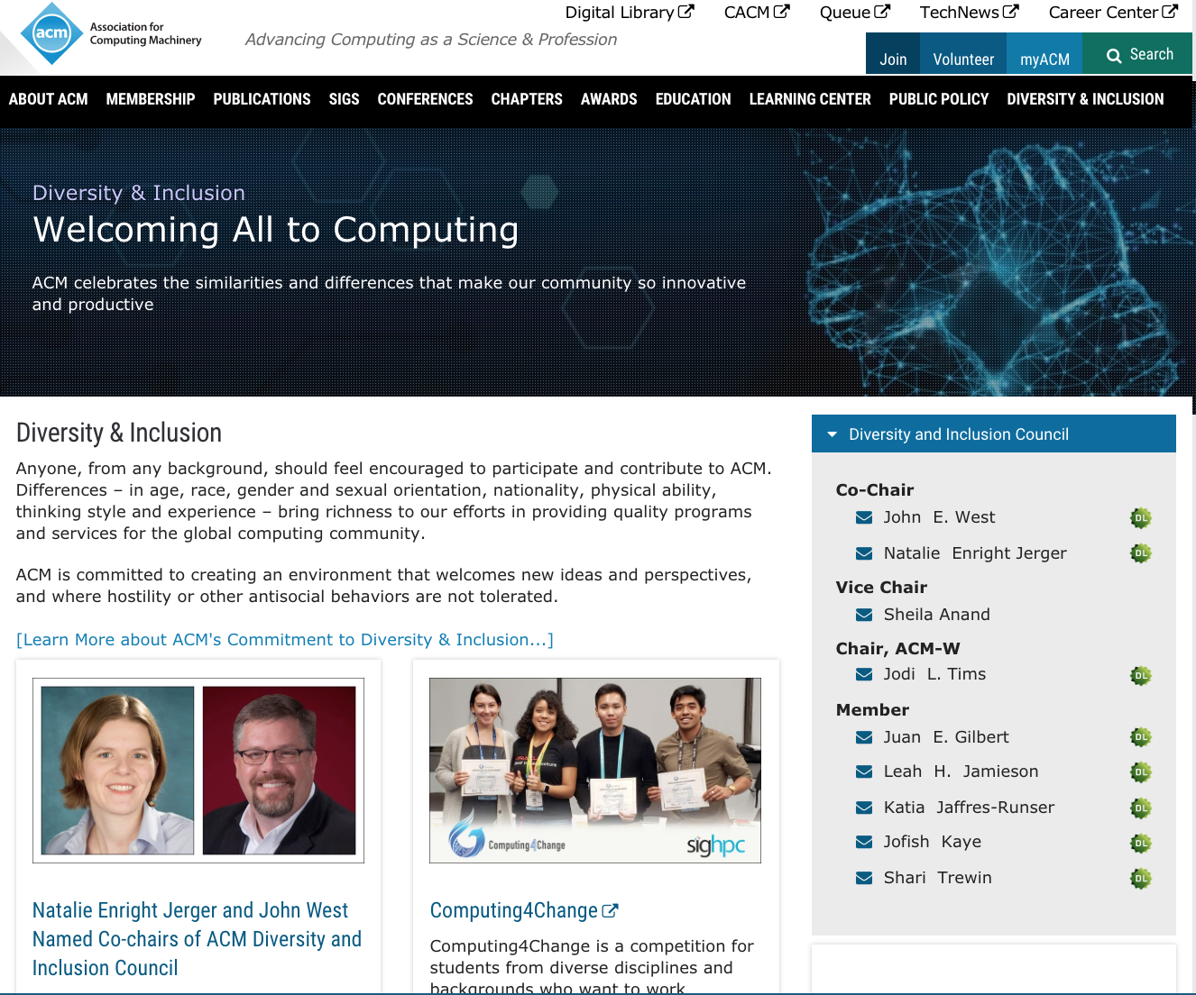

Slide 14


Slide 15

Future of Computing Academy (FCA)

Slide 16
Practitioner & Younger Generations Market Research
Interviews and Focus Groups
  Awareness, attitudes and opinions of ACM
  What are professional needs (career, skills, social, etc)?
  How are those needs currently met? (other organizations, resources, social groups, etc)
  How can ACM help meet these needs?
Members and non-members
  Testing in US, Europe, India, Canada
Findings: ACM brand well respected, although relationship with ACM viewed as distant and impersonal
  Not sure of how to make the most of membership
  Make ACM “feel small”

Slide 17
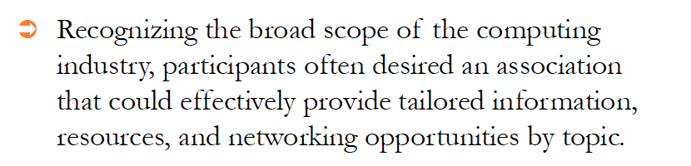
ACM Focus on ….
Filtered content through DL
Tailored by technical interests across ACM products and services
  Journals, conferences, magazines, software / data, promotion of speakers (Tech Talks), local meet-ups, online courses and books, captured videos (e.g., Turing Talks, Tech Talks, conference presentations)
DEMO

Slide 18


Slide 19
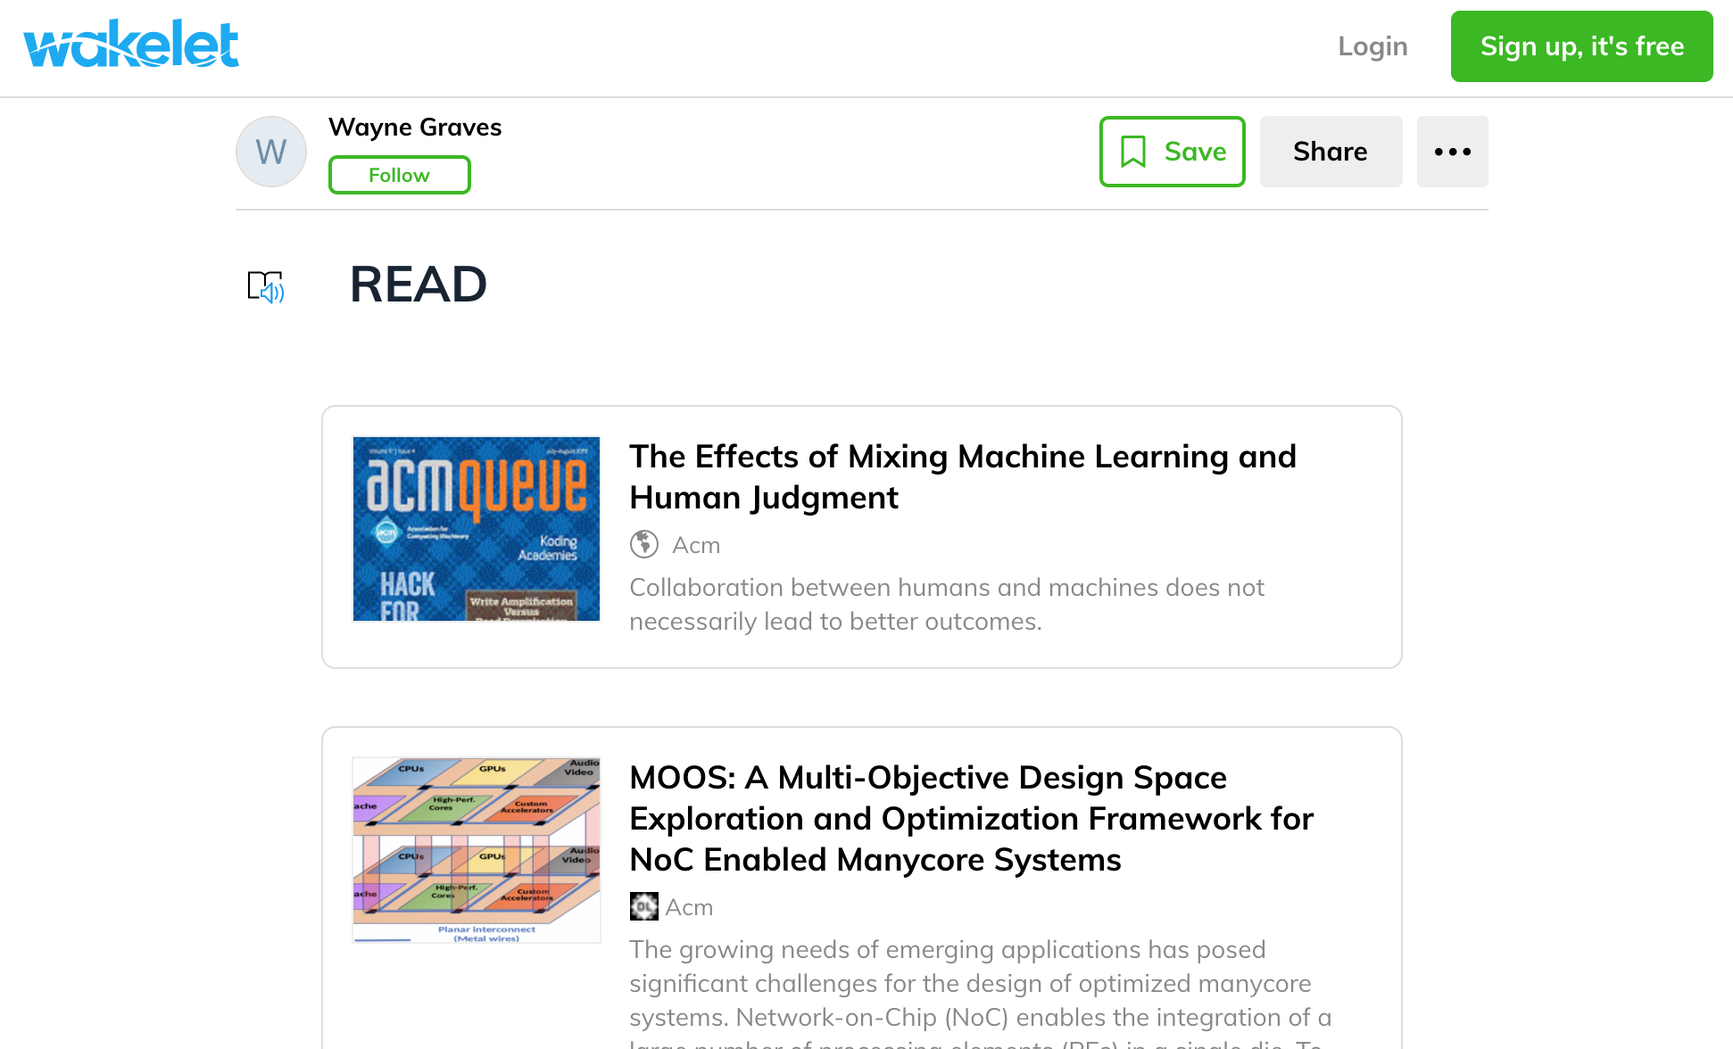

Slide 20
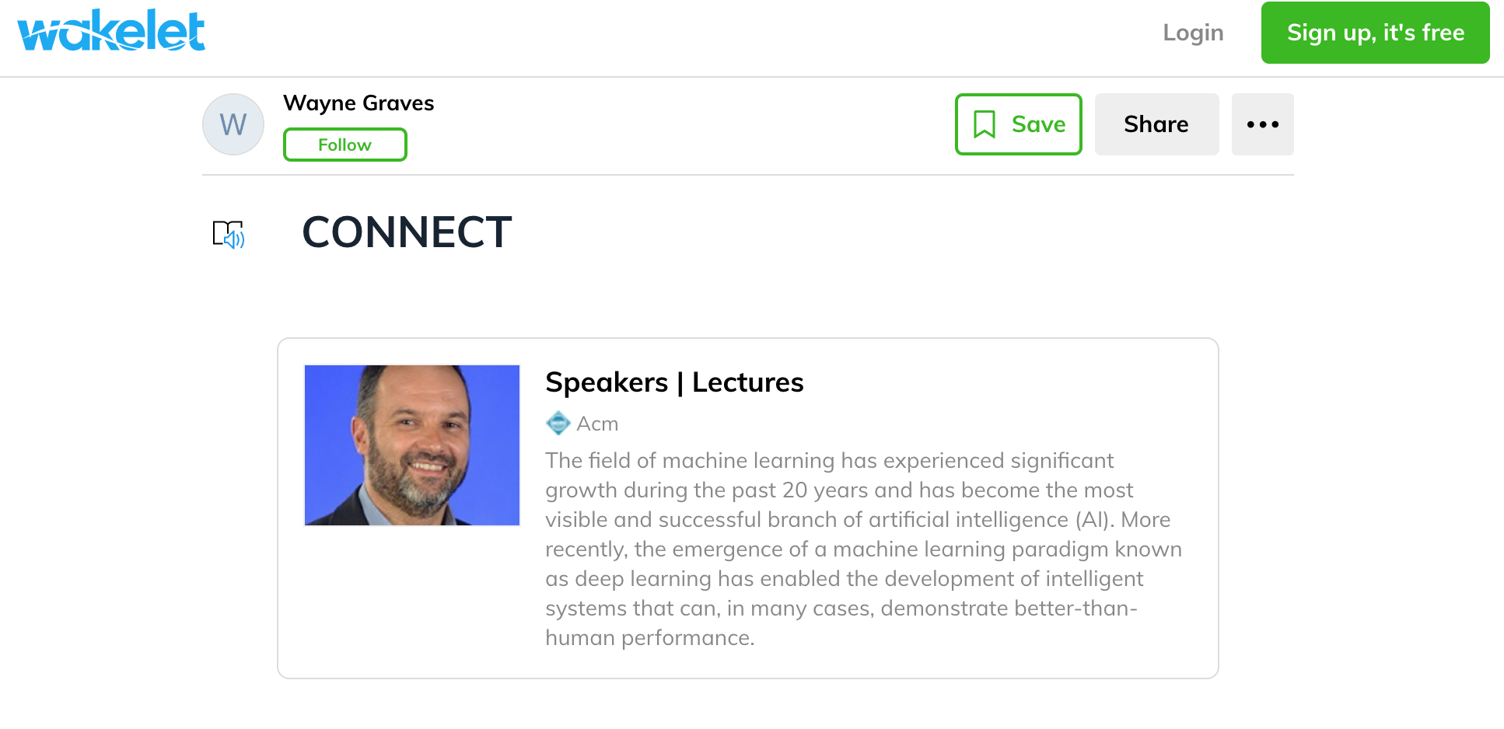

Slide 21


Slide 22
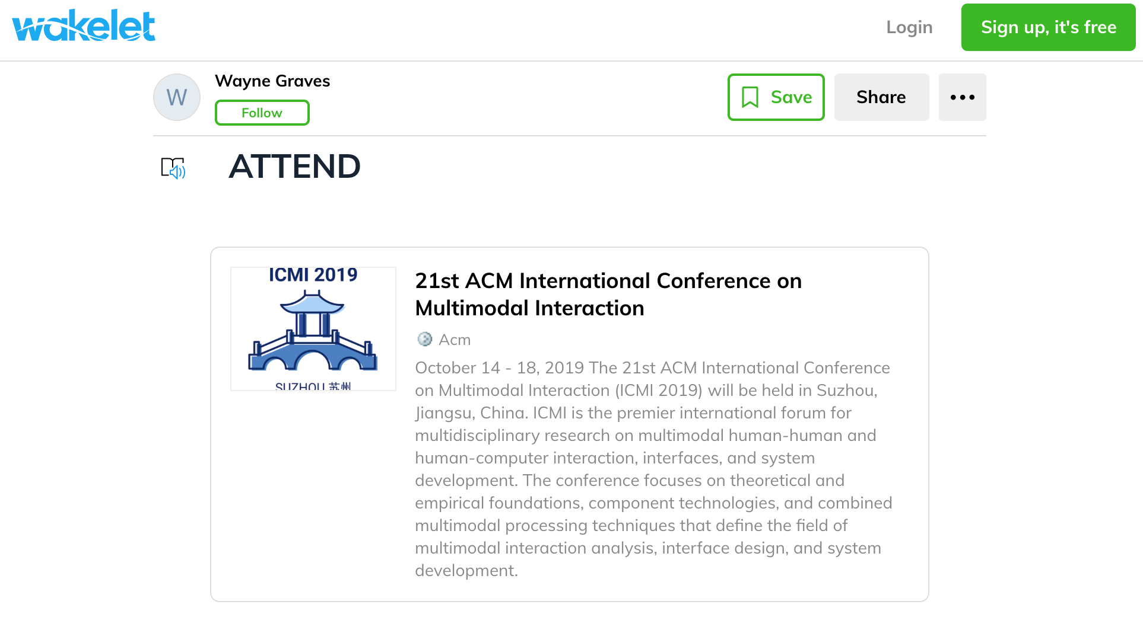

Slide 23
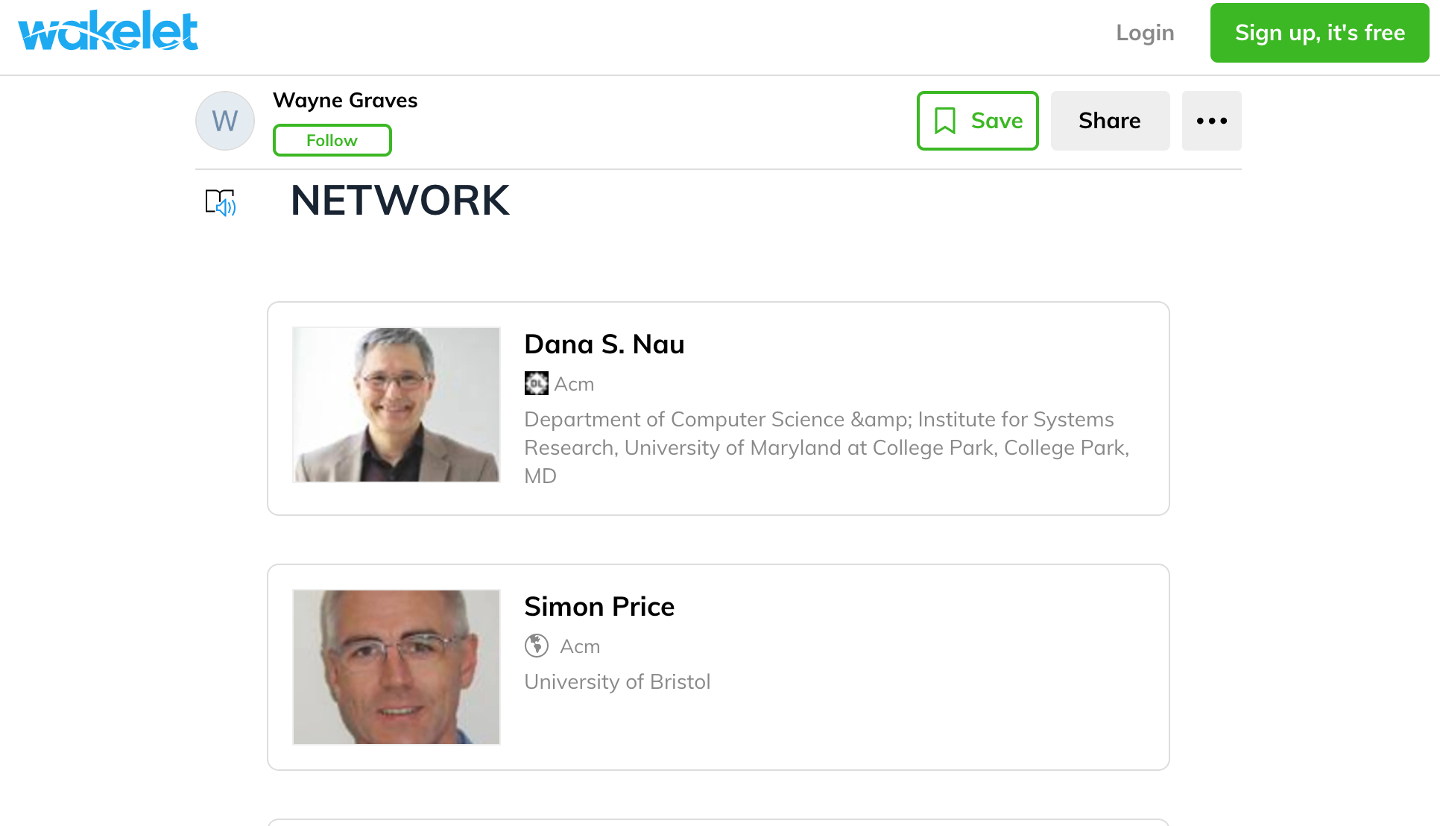

Slide 24
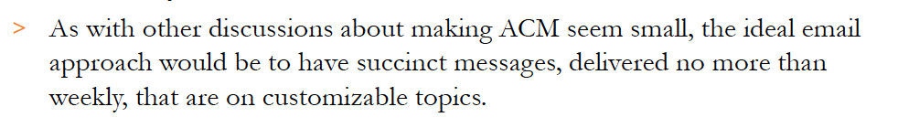
What’s New at ACM on ….
Two-pronged approach
  DL “Focus on …”
  Communications team plan
    Communication prompts “What’s New at ACM on ML”
Coordinated effort -- Anticipated Spring 2020

