Slide 1
ACM Author-Izer Service
The ACM Author-Izer Service allows every ACM author to place a link on their own web page or in an institutional repository which will allow visitors to obtain the definitive version of their article from the ACM Digital Library at no charge.
The ACM Author-Izer Service will also enable the author to display real-time download and citation statistics for each “authorized” article.

Slide 2
ACM Author-Izer Service
Requirements:
  An ACM Web Account
  An Author Page containing ACM published articles

Slide 3
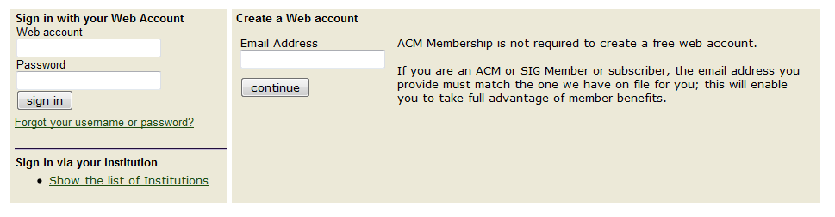
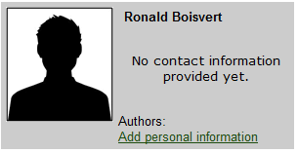
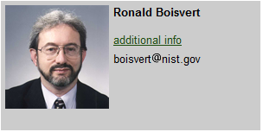
ACM Author-Izer Service
Create an ACM Web Account
Edit your Author Page

Slide 4
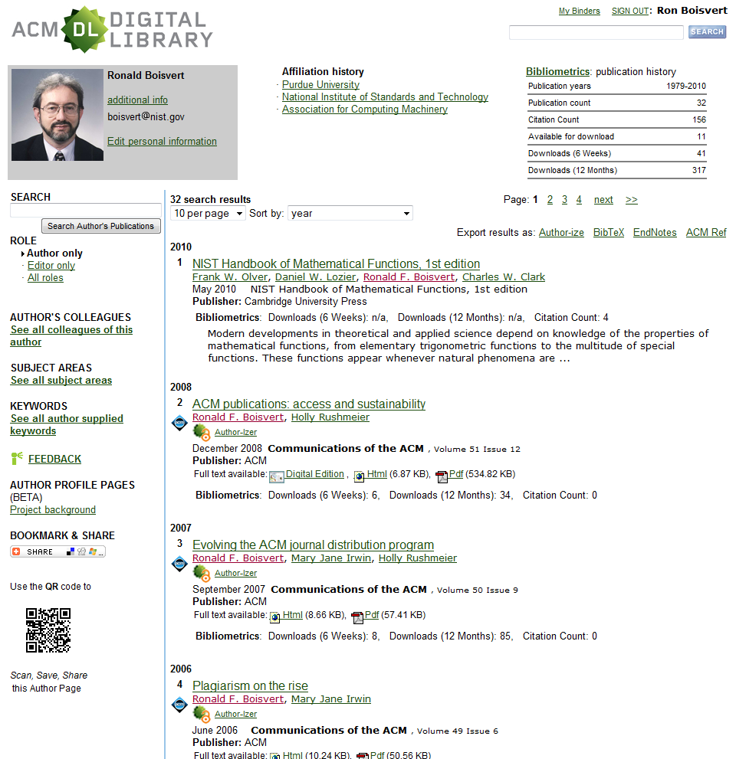
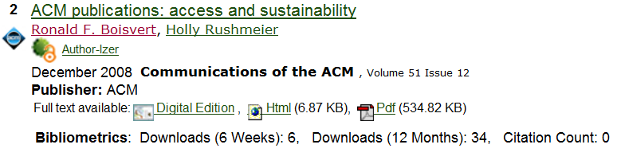
ACM Author-Izer Service
Author Page “Owner”
Author-Izer Service is available

Slide 5
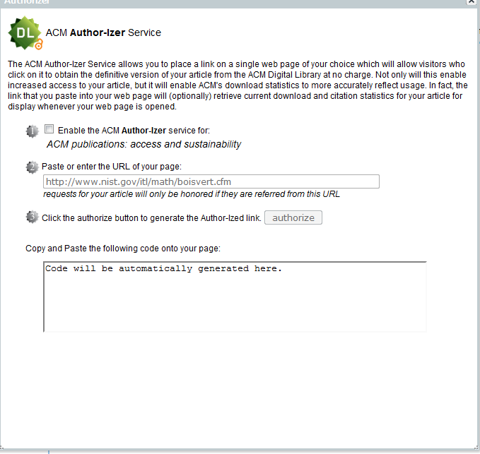

Slide 6
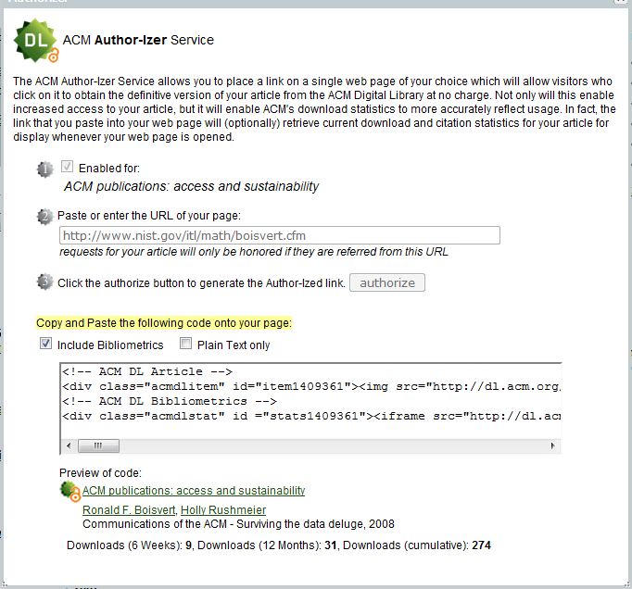

Slide 7
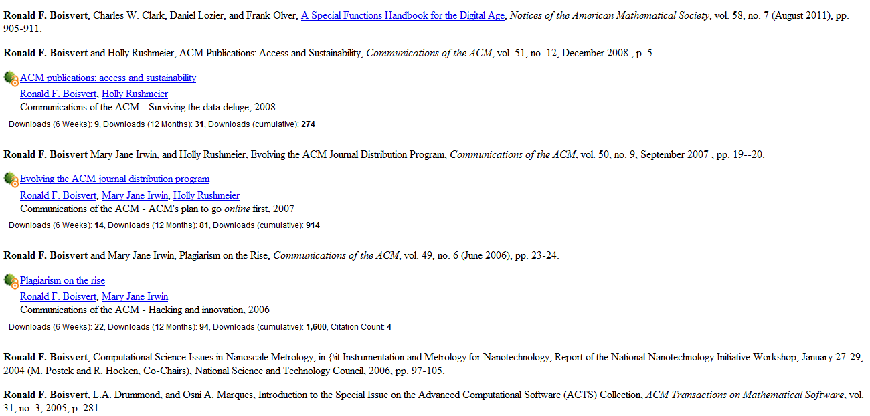
ACM Author-Izer Service
Authorized links

Slide 8
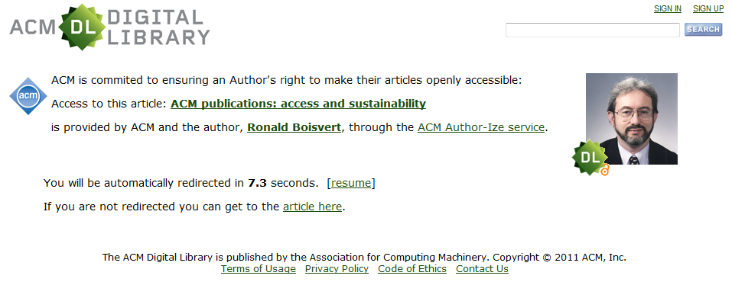
ACM Author-Izer Service
Landing page

Slide 9
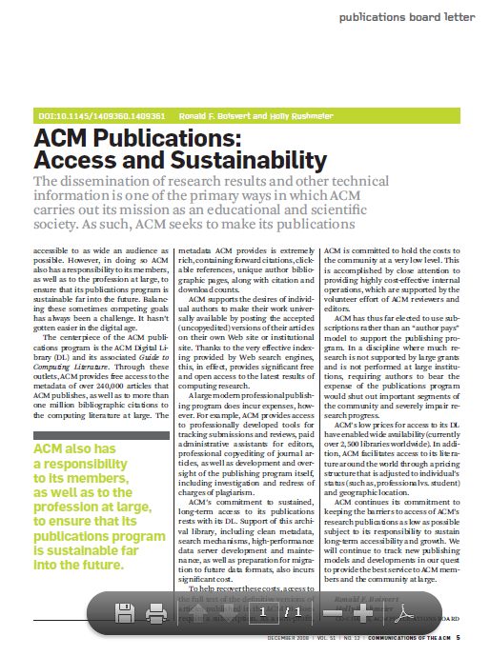
ACM Author-Izer Service
Full-Text Delivered

