Slide 1
The computing community consortium: catalyzing and enabling computing research
Gregory Hager Elizabeth Mynatt
Chair Vice Chair
Johns Hopkins Georgia Tech
Ann Drobnis
Director

Slide 2
Some Motivating Questions
How do we energize the community around “big ideas” that will create excitement and energy for computing and computational research?
How do we shape and articulate our relevance to national priorities?
How do we communicate these ideas, as a community, to science policy and funding leadership?

Slide 3
The Computing Community Consortium
Established in 2006 as a standing committee of the Computing Research Association
Funded by NSF under a Cooperative Agreement
  Second Award began in 2012,
  recently completed Reverse Site Visit
Facilitates the development of a bold, multi-themed vision for computing research – and communicates this vision to stakeholders
Led by a broad-based Council
Staffed by CRA

Slide 4
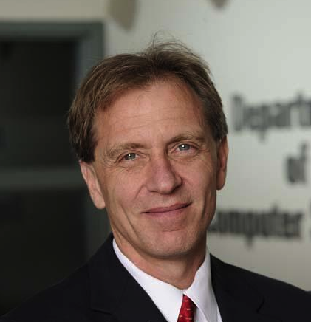


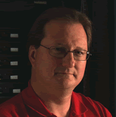
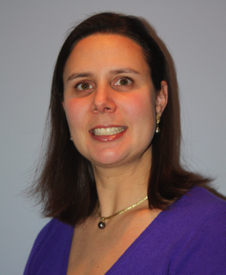



The CCC Council – executive committee
Greg Hager, Johns Hopkins Univ. (Chair)
Beth Mynatt, Georgia Tech (Vice Chair)
Susan Graham, UC Berkeley (Past Chair)
Bob Sproull, formerly Sun Labs, Oracle
Liz Bradley, University of Colorado, Boulder
Mark Hill, University of Wisconsin, Madison
Ann Drobnis, Director
Andy Bernat, CRA Executive Director
* Executive Committee
** 1 year leave

Slide 5



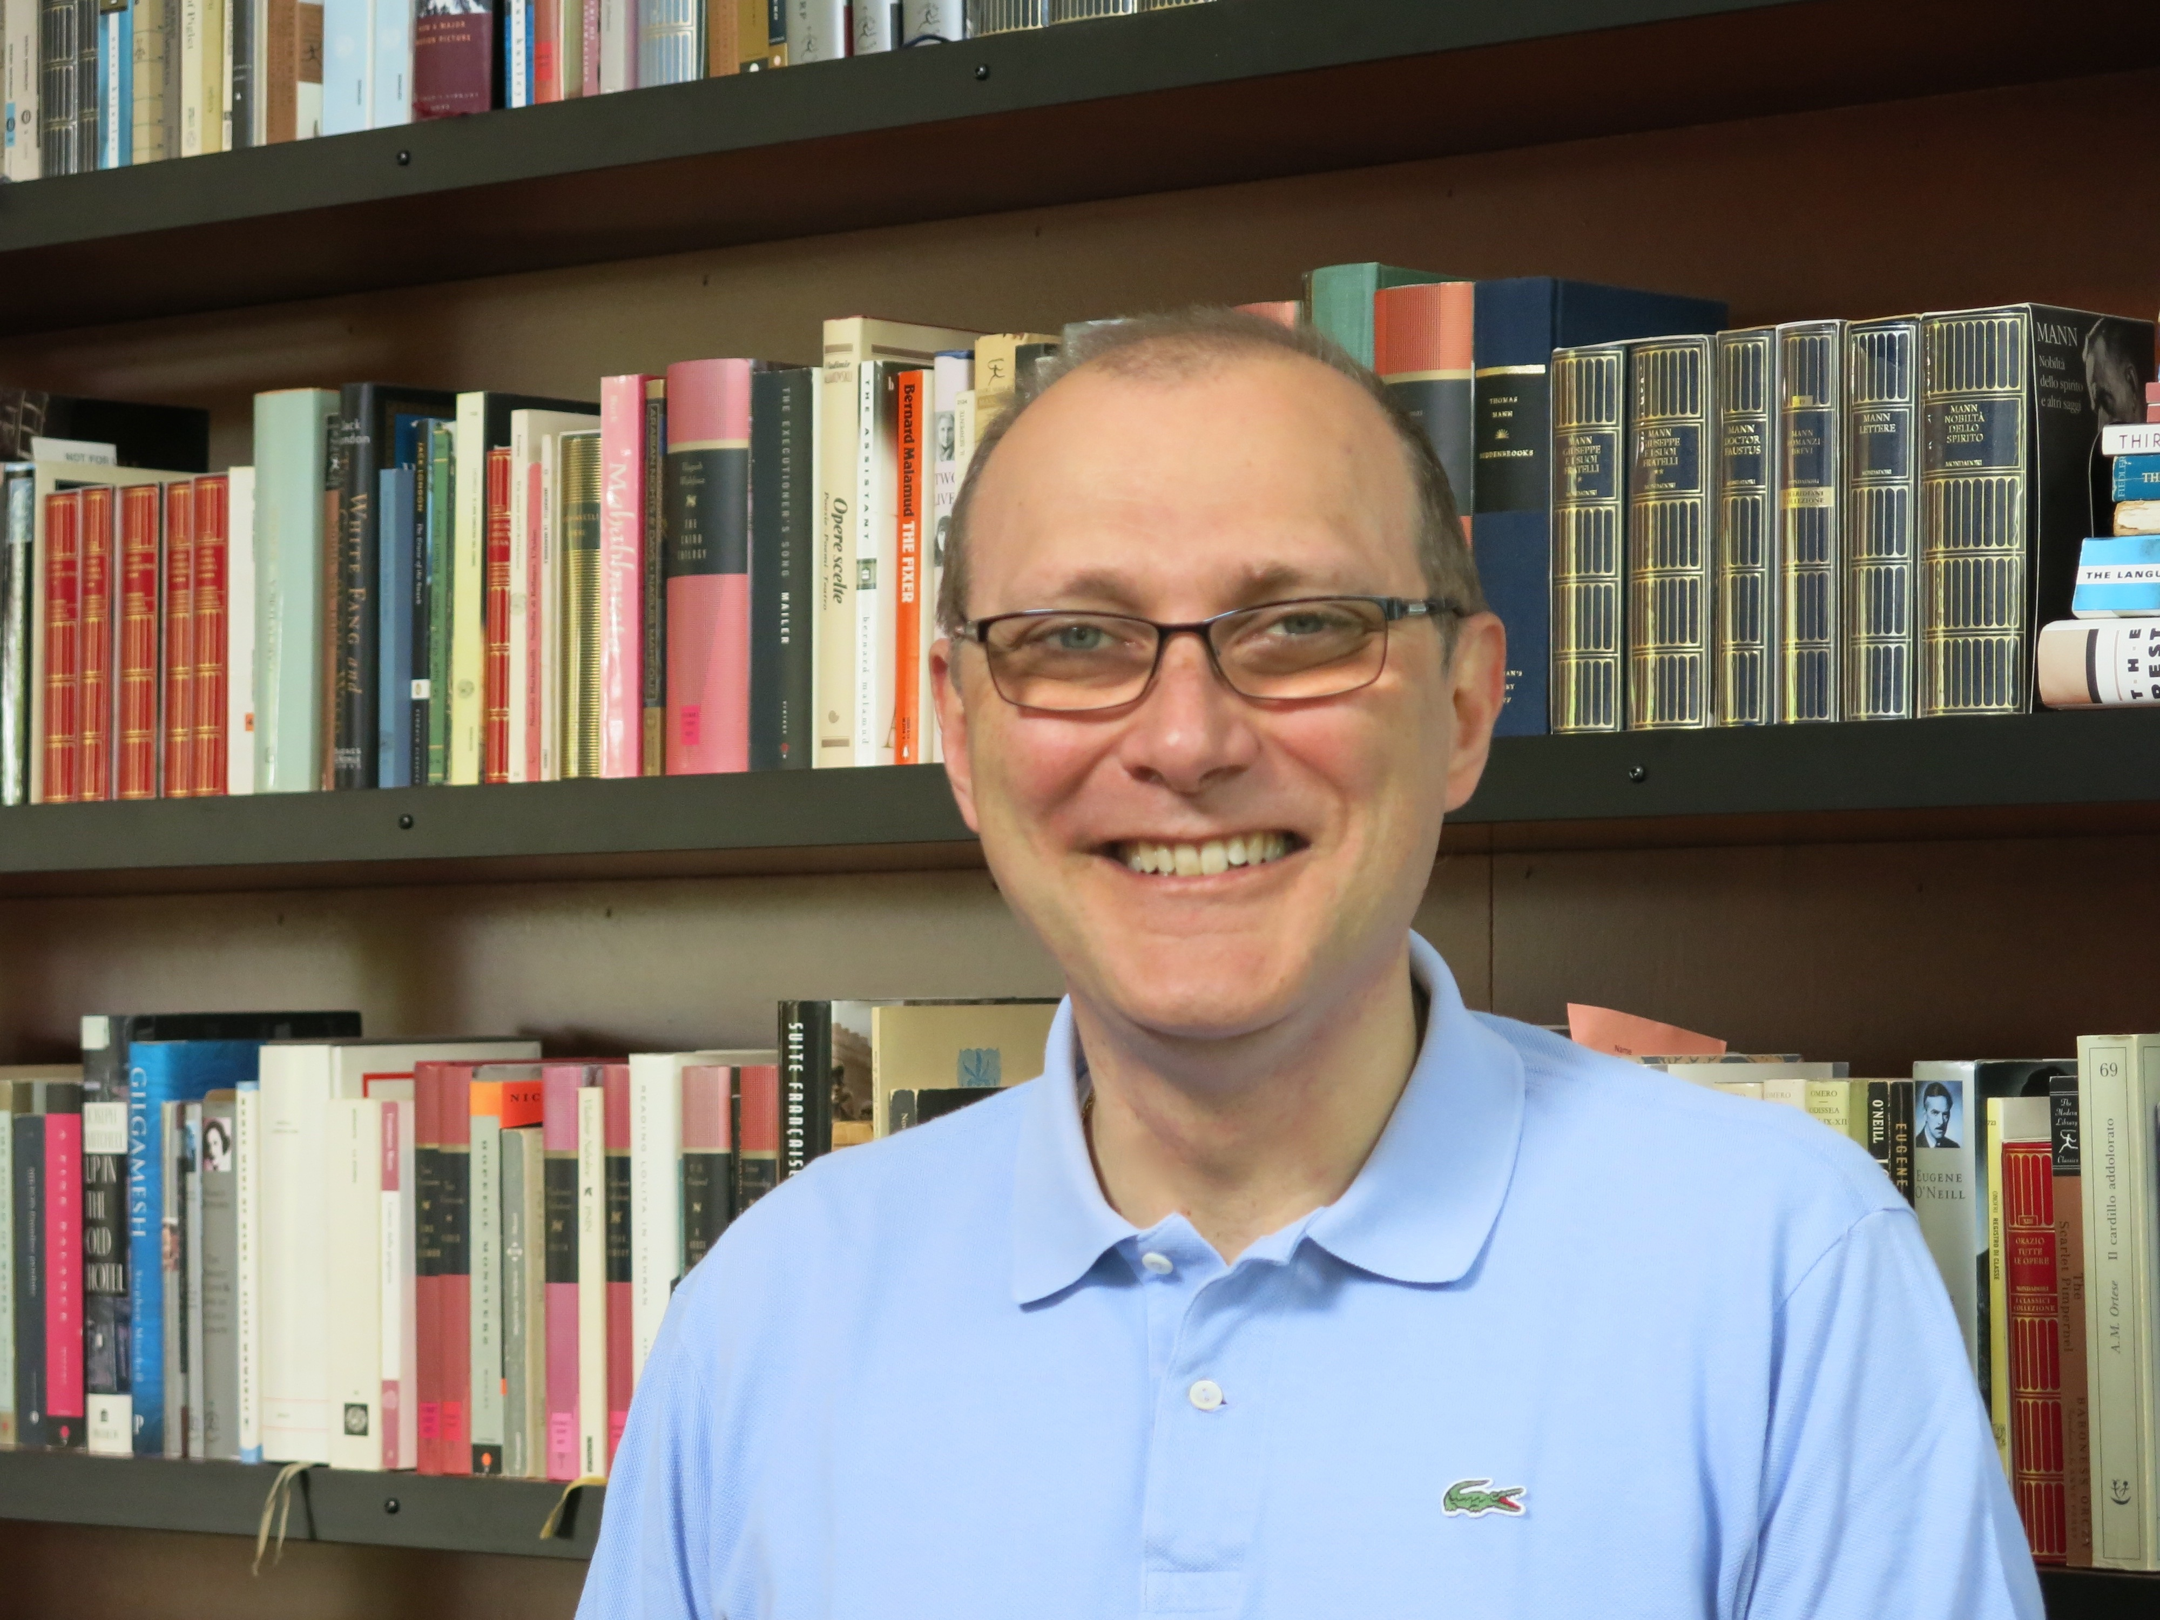
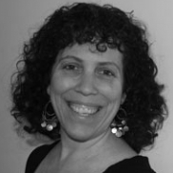


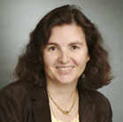
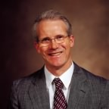
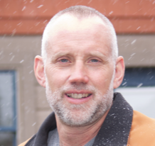
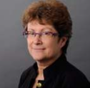




The CCC Council
Terms ending June 2017
  Lorenzo Alvisi, UT Austin
  Vasant Honavar, Penn State
  Jennifer Rexford, Princeton
  Debra Richardson, UC Irvine
  Klara Nahrstedt, UIUC
  Ben Zorn, Microsoft Research
Terms ending June 2016
  Randy Bryant, CMU**
  Limor Fix, formerly Intel
  Tal Rabin, IBM
  Daniela Rus, MIT
  Ross Whitaker, Univ. Utah
Terms ending June 2015
  Sue Davidson, Univ. Pennsylvania
  Joe Evans, Univ. Kansas
  Ran Libeskind-Hadas, Harvey Mudd College
  Shashi Shekhar, Univ. Minnesota
** 1 year leave

Slide 6
Our Mission
The mission of Computing Research Association's
Computing Community Consortium (CCC) is to:
catalyze the computing research community and
enable the pursuit of innovative, high-impact research.
CCC conducts activities that
strengthen the research community,
articulate compelling research visions, and
align those visions with pressing national and global challenges.
CCC communicates the importance of those visions to policymakers,
government and industry stakeholders, the public, and the research
community itself.

Slide 7
Our Mission
Catalyze and communicate the excitement of computing research
Align and articulate our contributions to other fields and to national priorities
Groom future leadership to help shape science policy

Slide 8
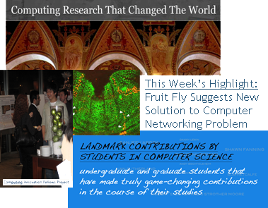
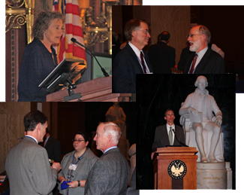
HOW DO WE DO IT?
Community-initiated visioning:
  Workshops to discuss “out-of-the-box” ideas
  Blue Sky Ideas tracks at conferences
Outreach to White House, funding agencies:
  Outputs of visioning activities
  Short reports to inform policy makers
  Task Forces – Health IT, Sustainability IT, Data Analytics
Communicating CS Research:
  CCC Blog [http://cccblog.org/]
  Computing Research in Action Video Series
  Research “Highlight of the Week”
  “The Impact of NITRD” symposium
Nurturing the next generation of leaders:
  Computing Innovation Fellows Project
  Leadership in Science Policy Institute

Slide 9
What Distinguishes CCC?
Proactive, rapid response
  Identify, plan, and execute in a matter of weeks to months
Community-based
  Find and foster ideas from germination to fruition and beyond
Leadership incubator
  Everyone is expected to do something!

Slide 10
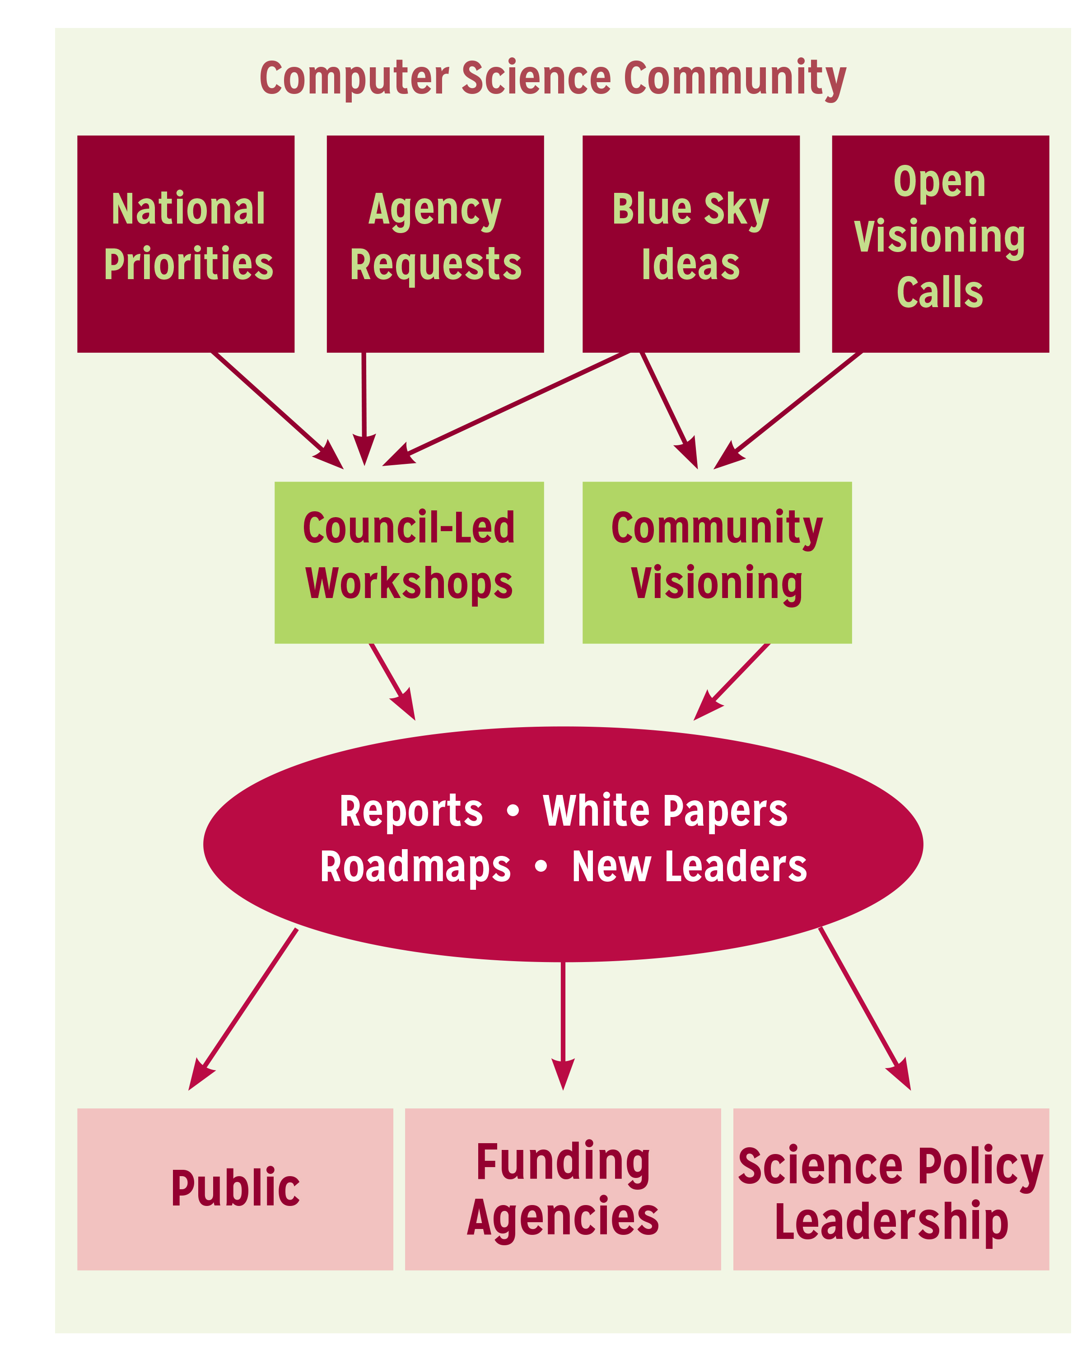
Visioning Goals
Communicate the role of CS research to stakeholders
Develop leadership capacity to help shape science policy
Notes:
Think of CCC is a bridge between the CS research community, the funders of that research, and the beneficiaries of that research. We work to promote the health of that enterprise.

Slide 11
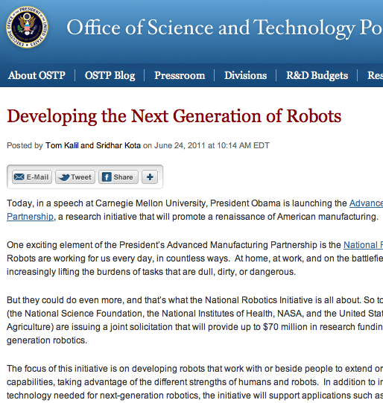


Catalyzing and Enabling: Robotics
4 meetings during
summer 2008
Roadmap published
May 2009
Extensive discussions
between visioning
leaders & agencies
OSTP issues directive to all
agencies in summer 2010
to include robotics in
FY 12 budgets
National Robotics
Initiative announced
in summer 2011
Henrik Chistensen
Georgia Tech
http://cra.org/ccc

Slide 12
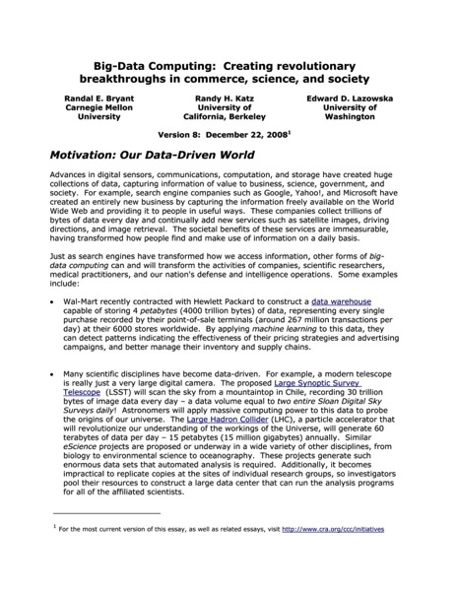
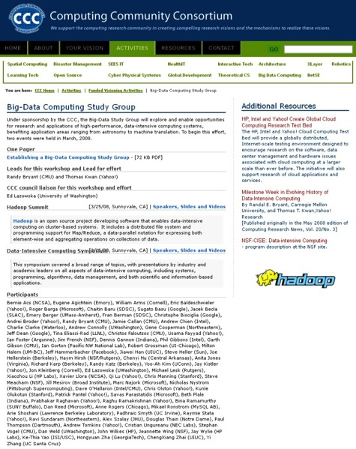
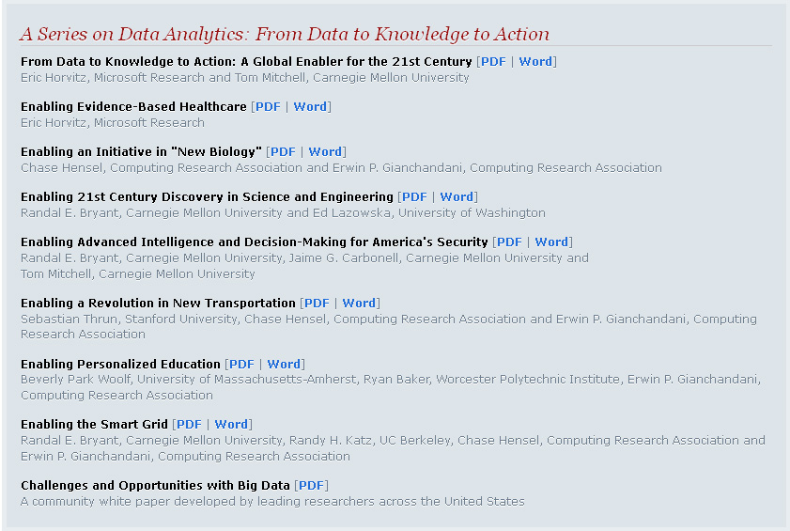
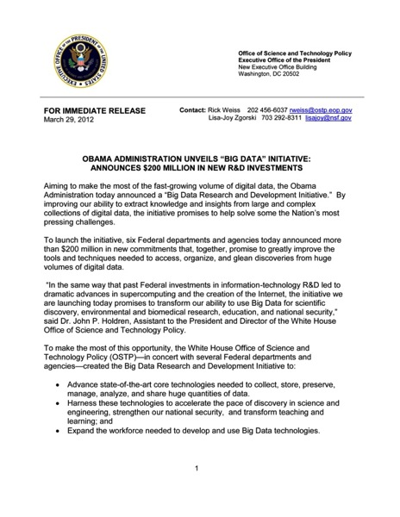
Catalyzing and Enabling: Big Data
2008
2008
2010
2012
http://cra.org/ccc

Slide 13
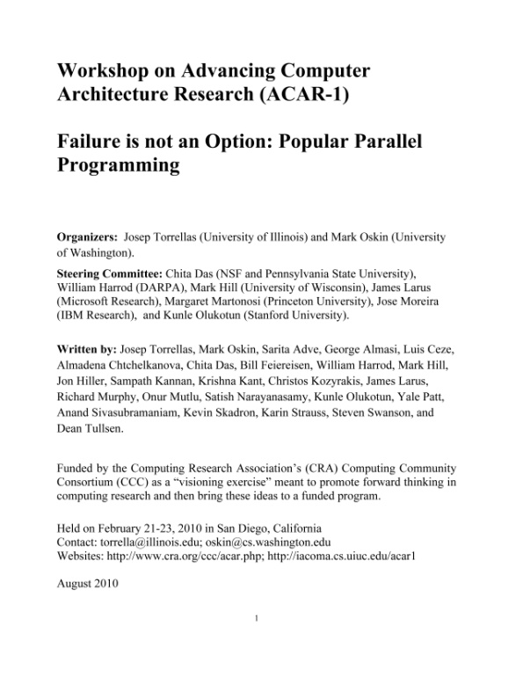
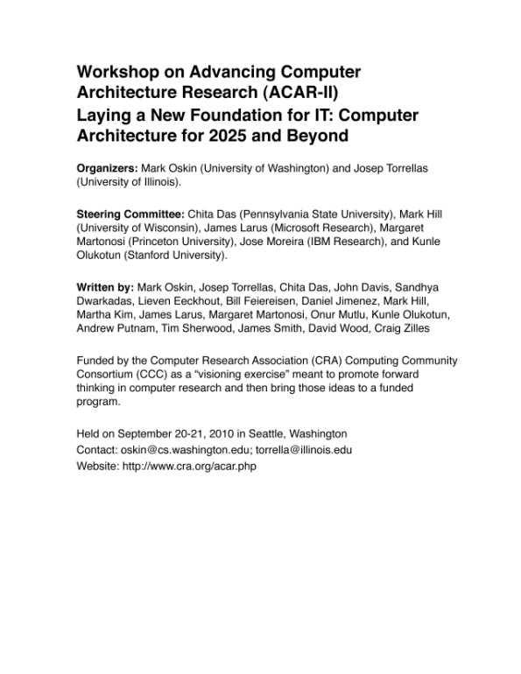
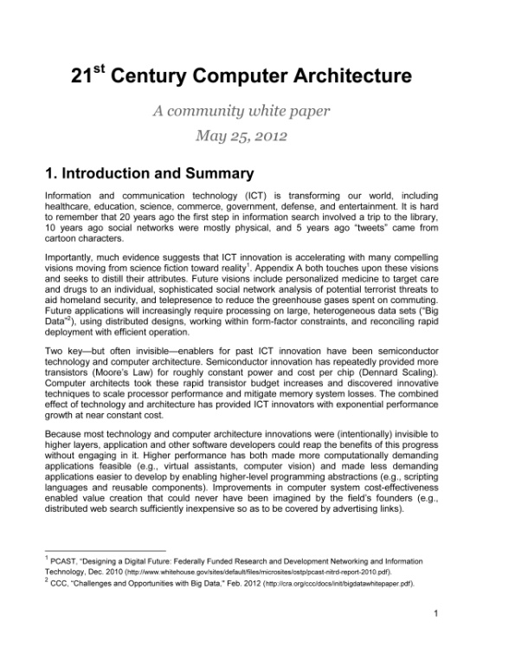
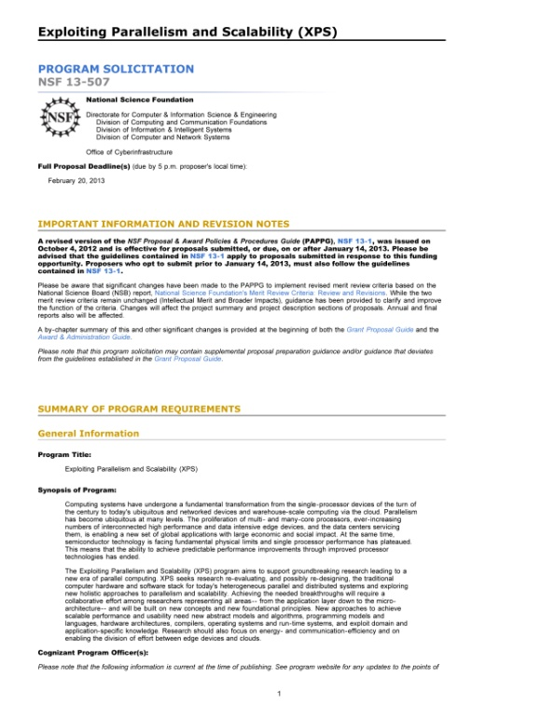
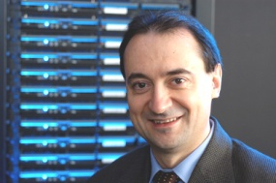
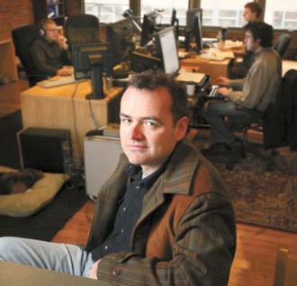
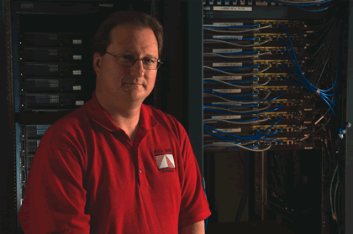


Catalyzing and Enabling: Architecture
2010
2010
2012
2013
Josep Torrellas
UIUC
Mark Oskin
Washington
Mark Hill
Wisconsin
http://cra.org/ccc

Slide 14

Catalyzing and Enabling: Health IT
October 2012 Workshop
Notes:
SHW first in 2010, updated in 2013 as a joint initiative with NIH

Slide 15
Blue sky ideas Conference Tracks
Special “Blue Sky Ideas” tracks at leading conferences
  Reach beyond usual papers
CCC provides prize money for top 3 papers
  Papers should be:
    open-ended
    “outrageous” or “wacky”
    Present new problems, new application domains or new methodologies
    Relatively short (4-6 pages)
    Published after the conference

Slide 16
Details
Conference Organizers write a proposal, indicating how papers will be solicited and reviewed
Blue Sky Chair and Director read proposals and determine viability
Once Track is approved, a CCC liaison is assigned
BS Chair or liaison may attend the Conference to present information about the CCC and the awards

Slide 17
Blue Sky Ideas Conference Tracks
BuildSys 2012
Computational Sustainability Track @ AAAI 2013
Computational Sustainability Award @ CHI 2013
Robotics: Science and Systems 2013
Conference on Innovation Data Systems Research (CIDR-2013)
Autonomous Agents and MultiAgent Systems (AAMAS-2014)
Upcoming:
  Foundations of Software Engineering 2014
  Association for the Advancement of Artificial Intelligence 2015

Slide 18
CCC: Catalyzing and Enabling Computing Research
Elizabeth Mynatt
CCC Vice Chair
Georgia Institute of Technology

